Slide 1
CLOUD COMPUTING
aleesha kurian
S3 MCA

Slide 2
INTRODUCTION
Cloud Computing provides us a means by which we can access the applications as utilities, over the Internet. It allows us to create, configure, and customize applications online.
With Cloud Computing users can access database resources via the internet from anywhere for as long as they need without worrying about any maintenance or management of actual resources.

Slide 3
What is Cloud?
The term Cloud refers to a Network or Internet. In other words, we can say that Cloud is something, which is present at remote location.
Cloud can provide services over network, i.e., on public networks or on private networks, i.e., WAN, LAN or VPN. Applications such as e-mail, web conferencing, customer relationship management (CRM), all run in cloud.

Slide 4
What is cloud computing?
Cloud Computing refers to manipulating, configuring, and accessing the applications online. It offers online data storage, infrastructure and application.
Cloud Computing is both a combination of software and hardware based computing resources delivered as a network service.

Slide 5
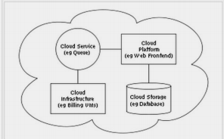
Cloud Computing Architecture

Slide 6
Basic Concepts
There are certain services and models working behind the scene making the cloud computing feasible and accessible to end users. Following are the working models for cloud computing:
1. Deployment Models
2. Service Models

Slide 7
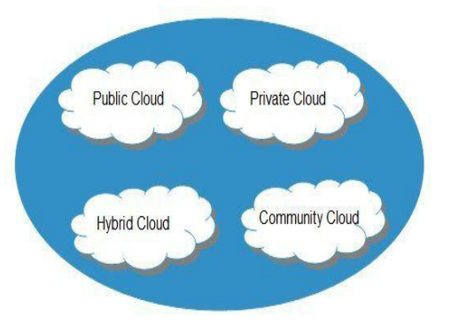
Deployment Models
Deployment models define the type of access to the cloud, i.e., how the cloud is located? Cloud can have any of the four types of access: Public Private, Hybrid and Community.

Slide 8
PUBLIC CLOUD : The Public Cloud allows systems and services to be easily accessible to the general public. Public cloud may be less secure because of its openness, e.g., e-mail.
PRIVATE CLOUD : The Private Cloud allows systems and services to be accessible within an organization. It offers increased security because of its private nature.
COMMUNITY CLOUD : The Community Cloud allows systems and services to be accessible by group of organizations.
HYBRID CLOUD : The Hybrid Cloud is mixture of public and private cloud. However, the critical activities are performed using private cloud while the non-critical activities are performed using public cloud.

Slide 9
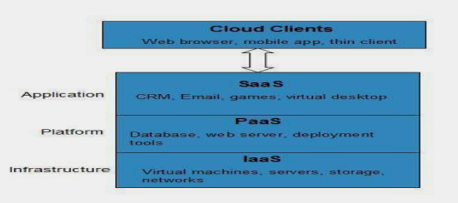
Service Models
Service Models are the reference models on which the Cloud Computing is based. These can be categorized into three basic service models as listed below:
1.Infrastructure as a Service (IaaS)
2. Platform as a Service (PaaS)
3. Software as a Service (SaaS)

Slide 10
Infrastructure as a Service (IaaS)
IaaS is the delivery of technology infrastructure as an on demand scalable service. IaaS provides access to fundamental resources such as physical machines, virtual machines, virtual storage, etc.
•Usually billed based on usage
•Usually multi tenant virtualized environment
•Can be coupled with Managed Services for OS and application support.

Slide 11
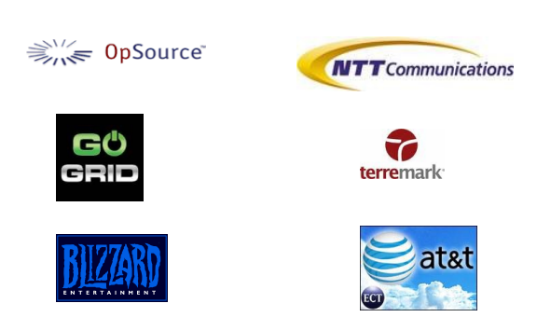
IaaS Examples

Slide 12
Platform as a Service (PaaS)
PaaS provides the runtime environment for applications, development & deployment tools, etc.
PaaS provides all of the facilities required to support the complete life cycle of building and delivering web applications and services entirely from the Internet.
•Multi tenant environments
•Highly scalable multi tier architecture

Slide 13
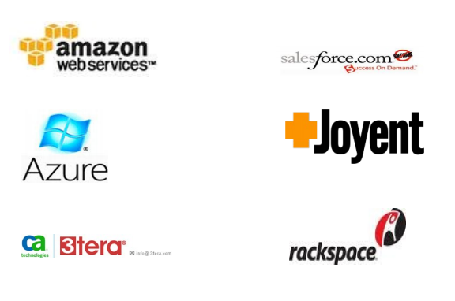
PaaS Examples

Slide 14
Software as a Service (SaaS)
SaaS model allows to use software applications as a service to end users.
SaaS is a software delivery methodology that provides licensed multi-tenant access to software and its functions remotely as a Web-based service.
• Usually billed based on usage
• Usually multi tenant environment
• Highly scalable architecture

Slide 15
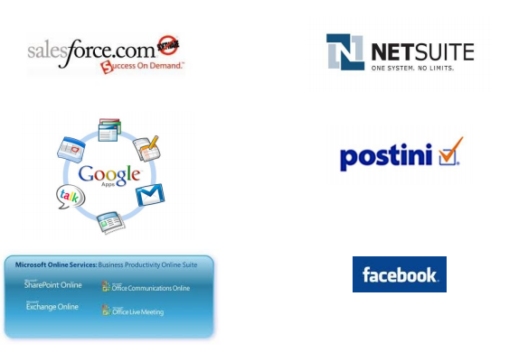
SaaS Examples

Slide 16
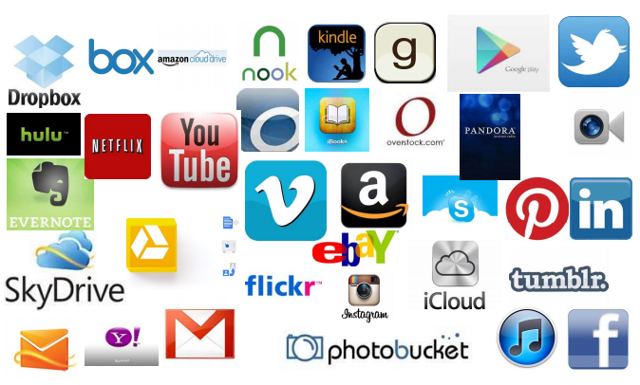
Do you Use the Cloud?

Slide 17
Advantages
Flexibility
Low Cost
Speed & Scales
Easier Management of Data and Information
Device Diversity
Increased Storage Capacity
Easy to Learn and Understand
Customize Setting

Slide 18
Disadvantages
Risk
Requires a Constant internet connection
Security
Migration Issue

Slide 19
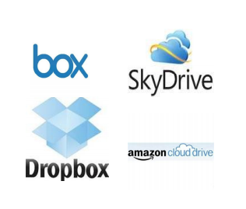
Cloud Storage
Create an Account User name and password.
Content lives with the account in the cloud.
Log onto any computer with Wi-Fi to find your content.

Slide 20
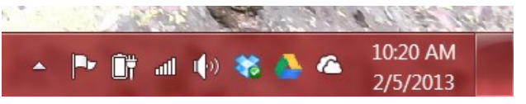
Download For Storage
Download a cloud based app to on your computer
The app lives on your Computer
Save files to the app
When connected to the Internet it will sync with the cloud
The Cloud can be accessed from any Internet connection

Slide 21
CONCLUSION
So, while cloud computing is really great and you’re probably already using it, either for business of for personal means.
Cloud computing is a really cheap way for companies to have all the resources they need in once place.
It’s a much better way to spread your resources, and it becomes easier to access things from longer distances.

Slide 22
THANK You…

